Slide 1
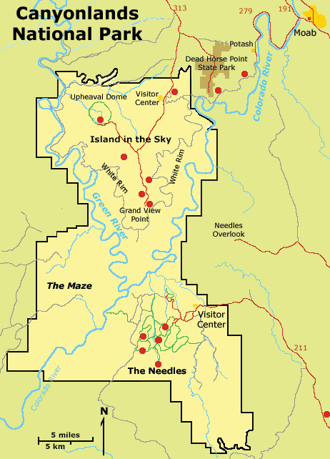
Notes:
The unusual behavior of salt in the Paradox Formation is subtly linked to many of the park’s attractions.

Slide 2
Notes:
For example, in the Island in the Sky district,

Slide 3
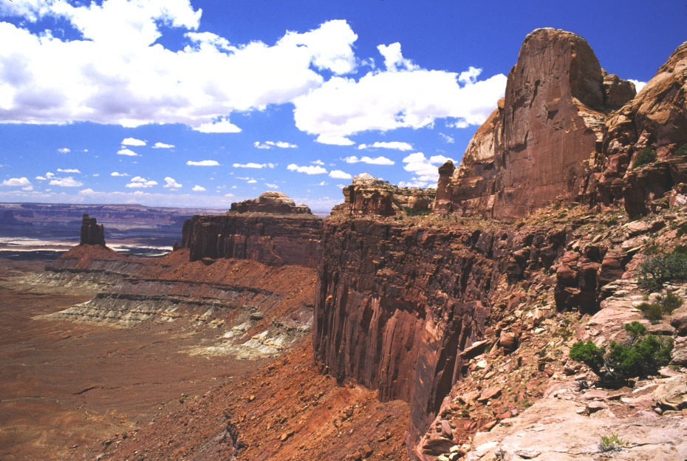
Green River Overlook, Island in the Sky
Notes:
… near the Green River Overlook, …

Slide 4
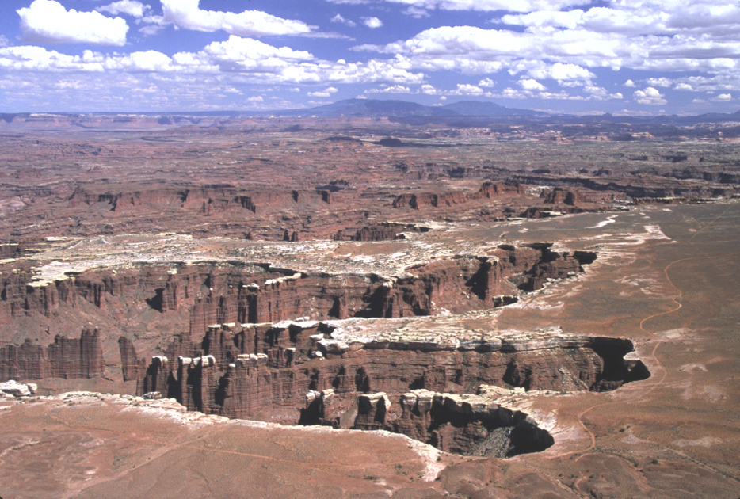
Organ Rock Shale and White Rim SS from Grand View Point
Notes:
… stress from the movement of salt gently folded the overlying, relatively plastic Organ Rock Shale while the brittle layer of White Rim Sandstone above it developed a system of evenly spaced vertical joints.

Slide 5
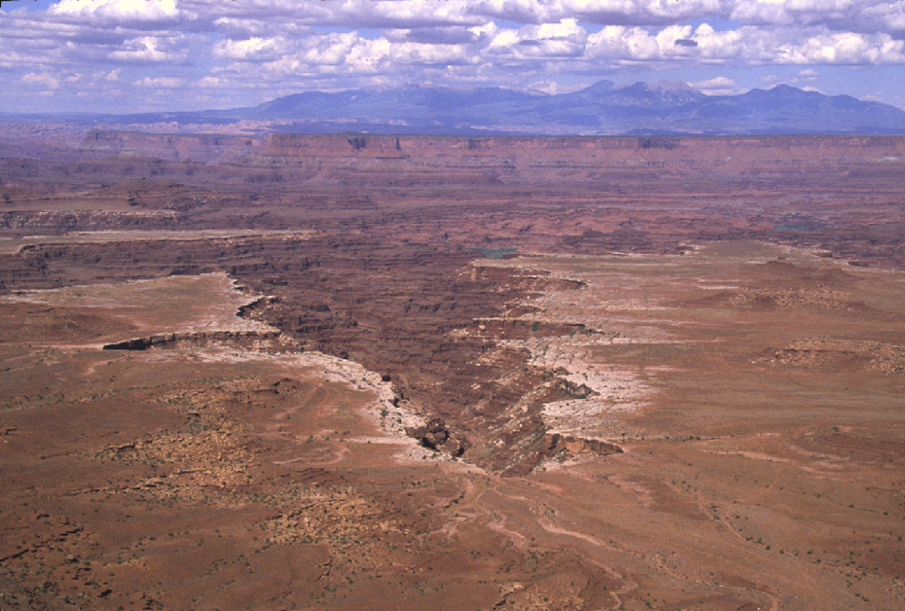
Headward erosion of Organ Rock Shale
Notes:
The far more erodible shale tends to be scoured out from under the sandstone by headward stream erosion.

Slide 6
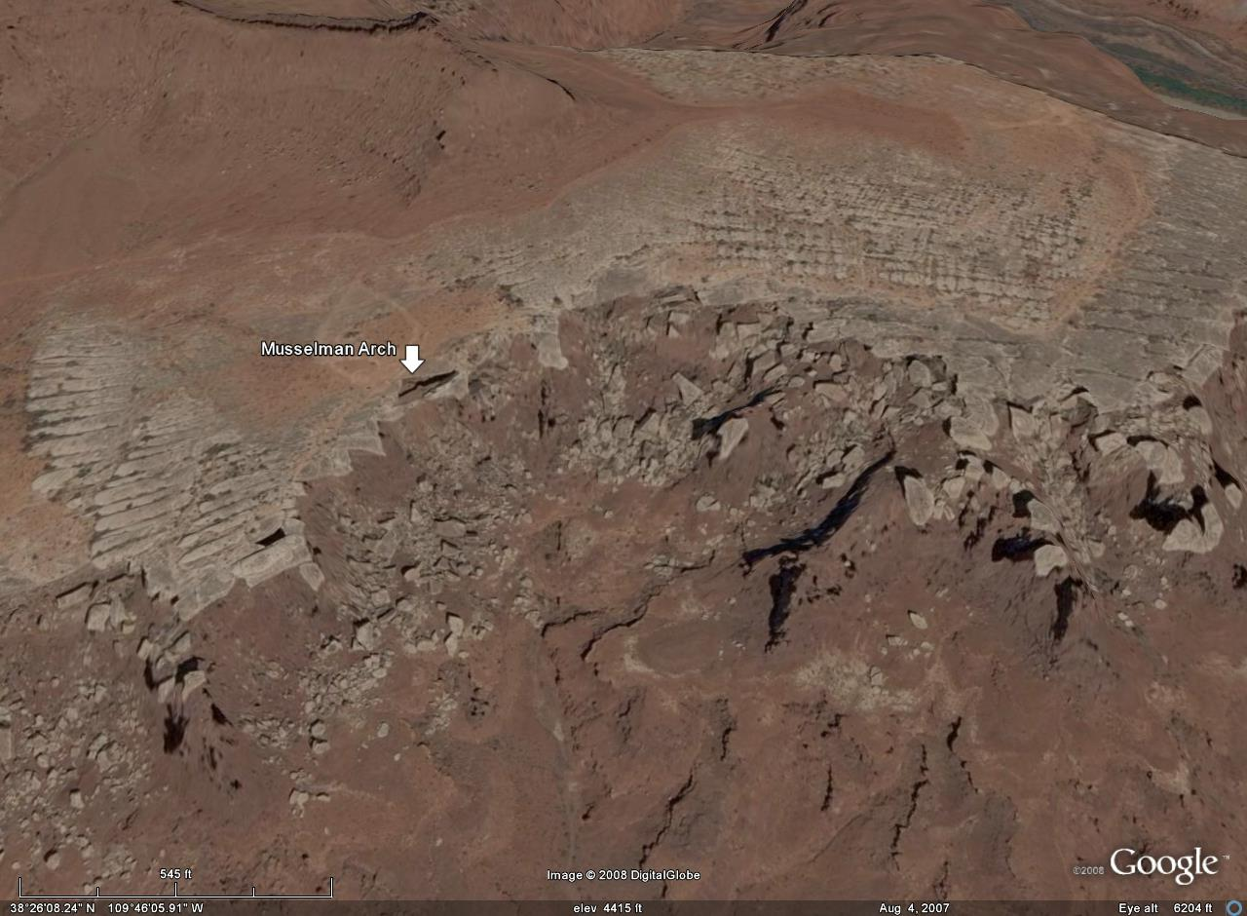
Vertical joint systems
Notes:
As the shale is removed, the fractured sandstone eventually gives way and slides down the steep shale slope. Except at Musselman Arch …

Slide 7
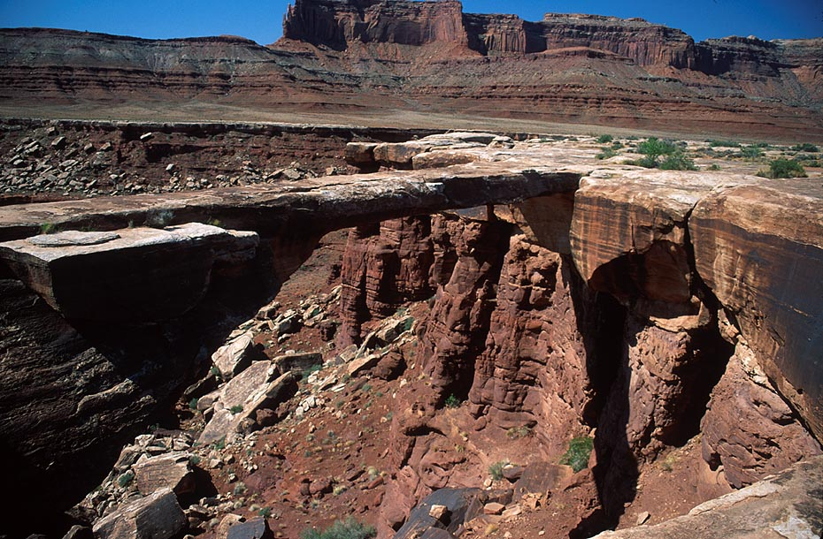
Musselman Arch (White Rim Sandstone)
joint surface
Notes:
… where one tenacious slab of sandstone remains completely unsupported by shale.

Slide 8
Notes:
The effects of salt motion…

Slide 9
Notes:
….are perhaps most apparent in the Needles District.

Slide 10
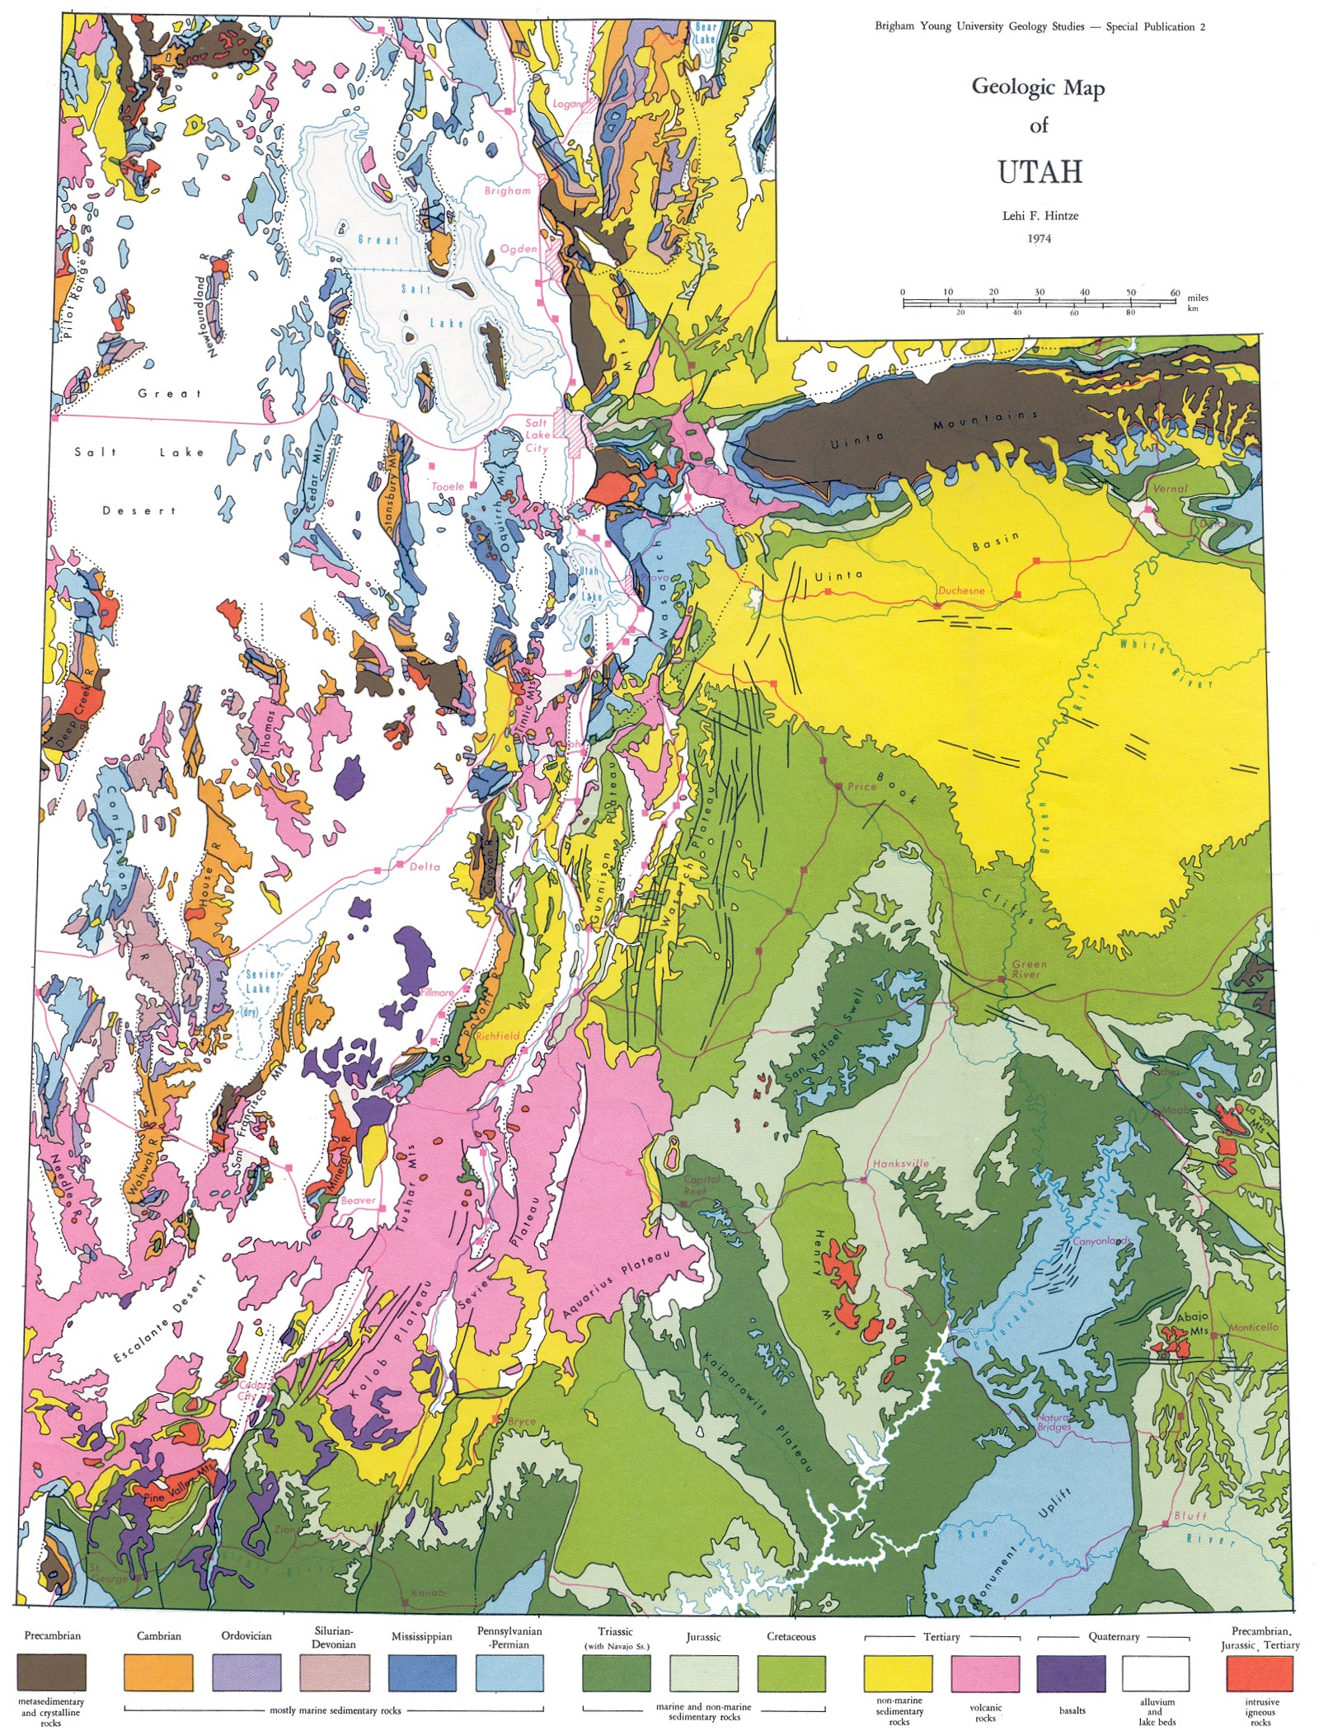
Needles District
Monument Uplift
Notes:
But here, because it is closer to the center of the Monument Uplift, the resistant White Rim Sandstone is completely eroded as is much of the underlying Organ Rock Formation ….

Slide 11
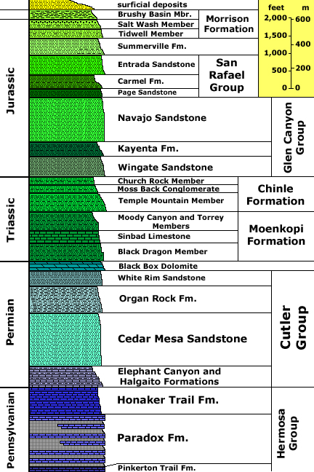
Units exposed in Needles District
Notes:
… such that the Cedar Mesa Sandstone is largely exposed with a few interfingering beds of Organ Rock Formation.

Slide 12
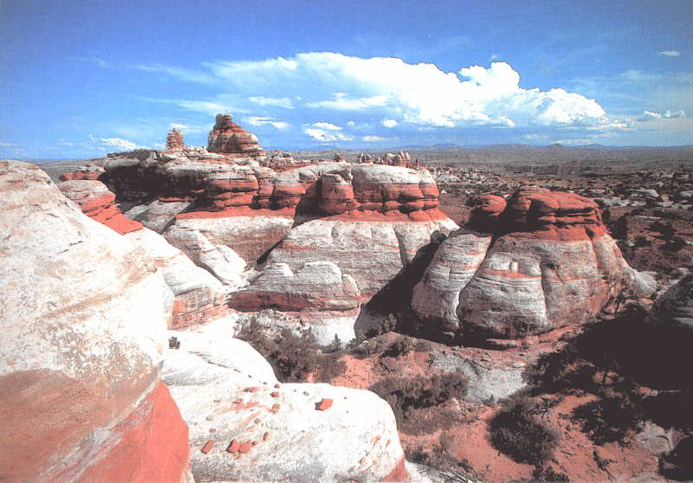
Typical Needles District Strata
Organ Rock Formation
Cedar Mesa Sandstone
Notes:
This gives outcrops in the area a distinct red and white striped appearance.

Slide 13
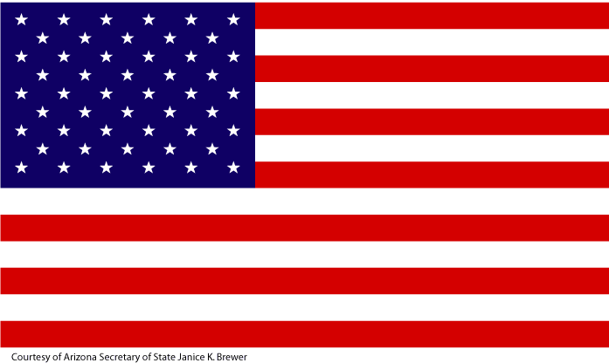
RED, WHITE and BLUEtiful!
Notes:
Against the blue sky of southern Utah, what could be more American?

Slide 14
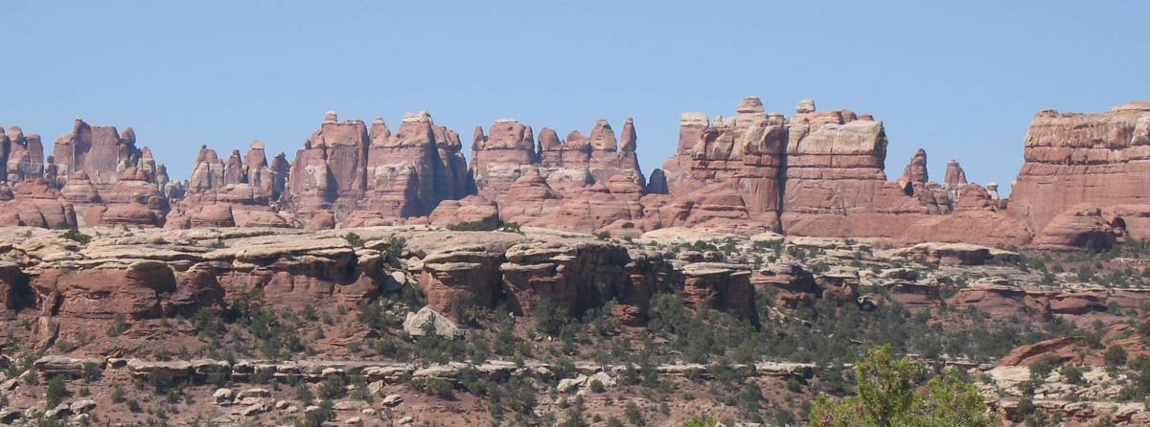
Needles District
Notes:
Anyway, getting back to the salt story, the Needles District is named for the pointed columns formed from intersecting vertical joint systems.

Slide 15
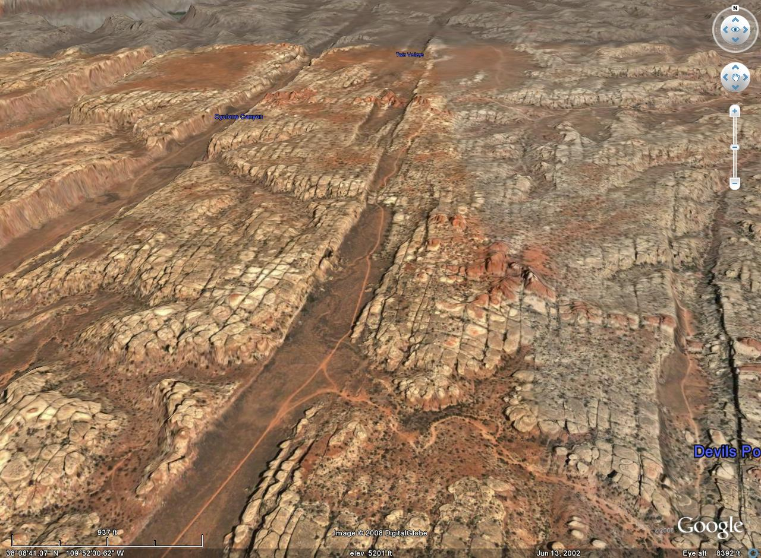
Dominant joints
salt graben
salt graben
Notes:
The dominant joint system here runs parallel to the salt grabens and was no doubt formed by tensional stresses produced as these rocks slid toward the Colorado River over the plastic salt deposits below.

Slide 16
salt graben
salt graben
secondary joints
Notes:
The second set of joints cuts across the first and is probably related to stress associated with the Monument Uplift and/or unseen salt anticlines below.

Slide 17
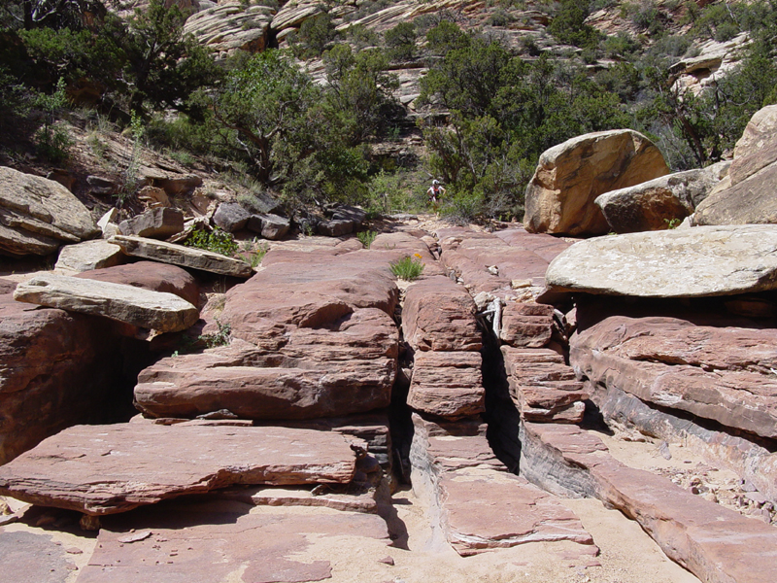
Notes:
Weathering and erosion widen the joints …

Slide 18
Principle joint system
Fins
Notes:
… leaving progressively smaller remnants of the rock between the joints. Most of the erosion occurs along the principle joint system, forming long, vertical slabs of rock called “fins”.

Slide 19
Secondary joint system
Notes:
In time, the secondary joint systems are eroded and enlarged as well…

Slide 20
Columns
Notes:
… converting the fins into as series of columns.

Slide 21
Cave
Arch
Notes:
Weaker rock regions do not always occur along the joint systems. During the conversion of sediment to rock, the distribution of sand-cementing minerals may be uneven, which results in differential erosion. Caves form where erosion rates are greatest. In time, caves enlarge and sometimes penetrate to the other side of the fin to form arches.

Slide 22
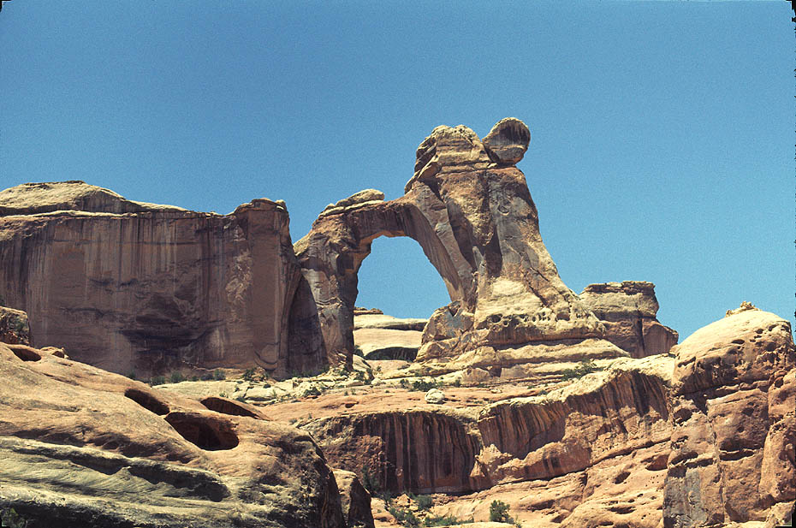
Angel Arch
Notes:
Although Canyonlands has only about 30 natural arches compared to 300-or-so in nearby Arches National Park, those in Canyonlands tend to have more have more complex shapes due to the variability of the Cedar Mesa Sandstone they occur in and the greater complexity of the joint systems in Canyonlands. Angel Arch and …

Slide 23
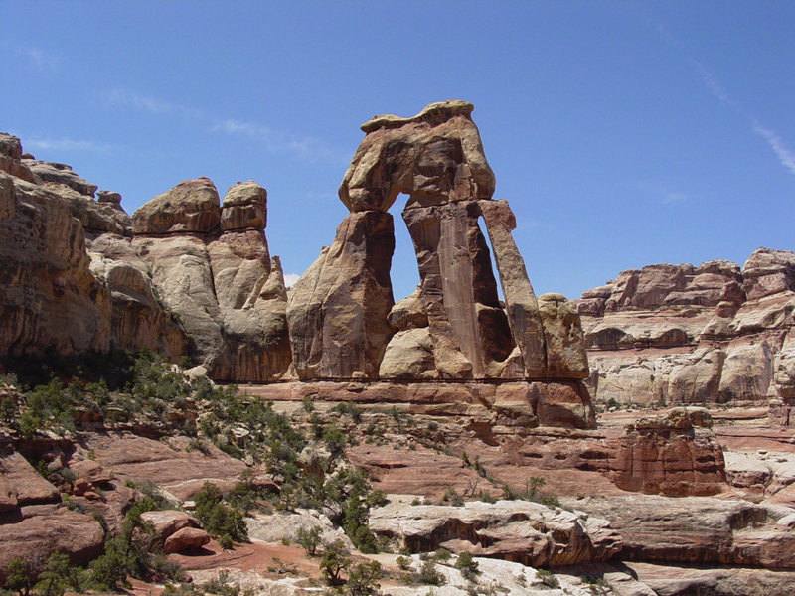
Notes:
… the towering Druid Arch formed from the weathering and erosion of massive fins of Cedar Mesa sandstone. Both are in the Needles District.

Slide 24
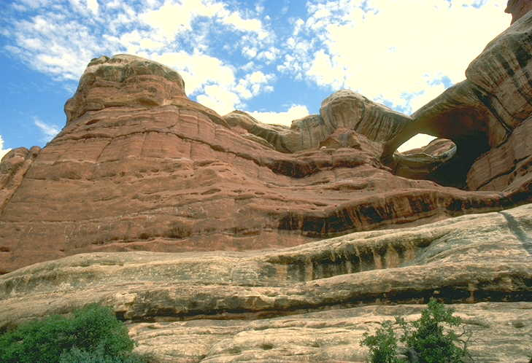
Paul Bunyan’s Potty
Notes:
Also in the Needles District is the rare horizontal arch known as Paul Bunyan’s Potty. It is one Canyonlands’ few attractions that is not related to the action of the Paradox salt deposits.

Slide 25
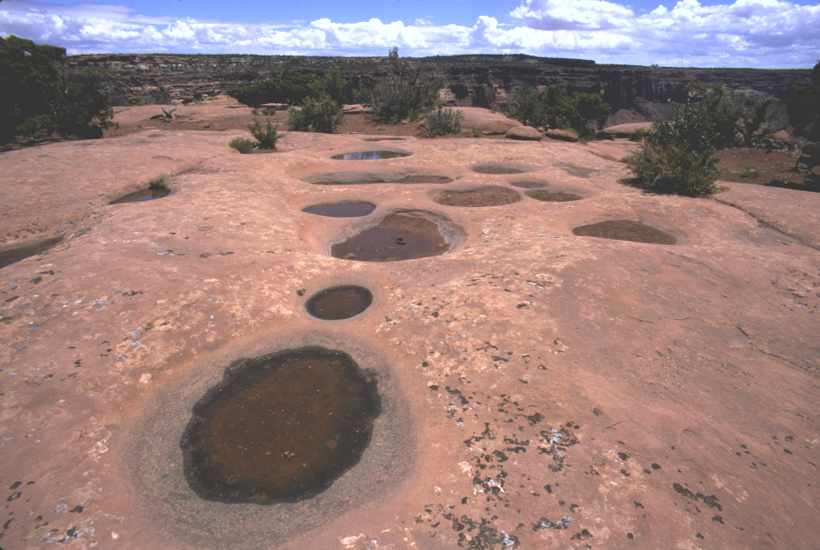
Potholes in calcite-cemented sandstone
Notes:
Horizontal arches begin as potholes which form on calcite-cemented sandstone, where standing water accelerates the dissolution of calcite producing bigger potholes, which hold more water and therefore cause even more erosion.

Slide 26
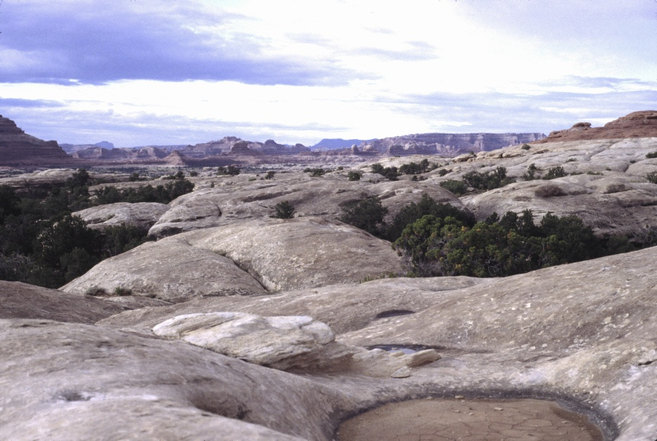
Navajo Sandstone, Needles District
Notes:
Paul Bunyan’s Potty is formed within the particularly lime-rich Navajo Sandstone.

Slide 27
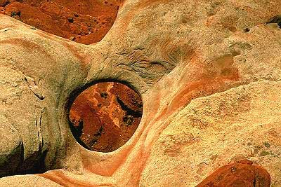
Notes:
As seen from the air, it is easy to see how this arch is just an overgrown pothole that eroded a weak spot in a hard layer of sandstone down to a much more erodible layer below.

Slide 28
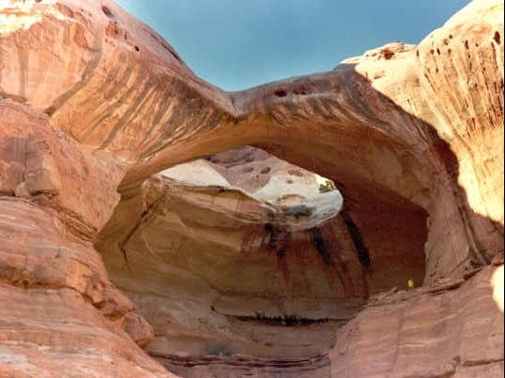
person for scale
Notes:
From the right angle it really does look like a giant toilet seat.

Slide 29
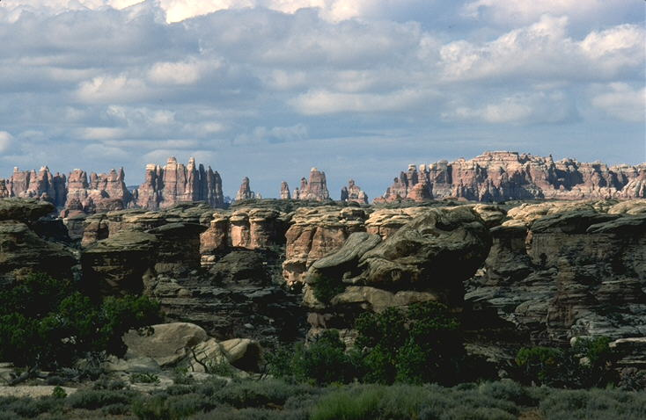
The Needles
Notes:
But mostly what one sees in the Needles District are thousands of needles.

Slide 30
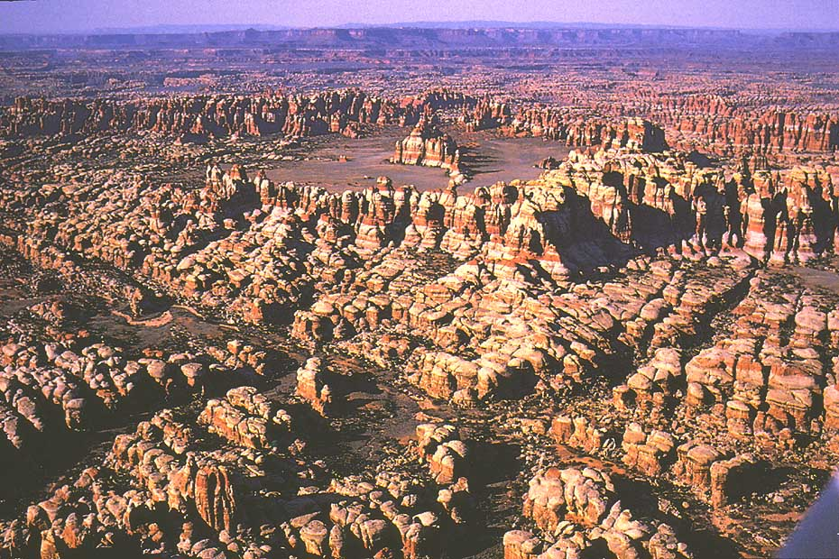
Chester Park
Notes:
Chester Park is a large desert meadow surrounded by a sea of needles. Open areas like this form where there is an unusually high concentration of closely-spaced, intersecting joints.

Slide 31
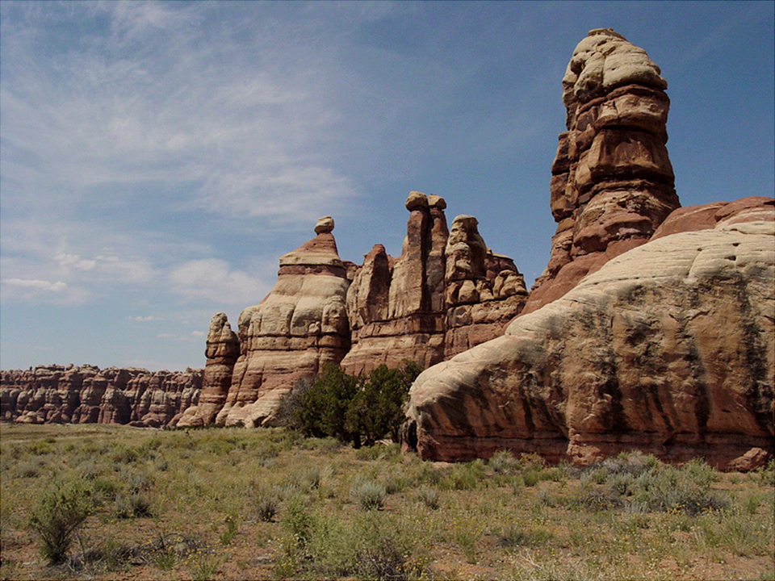
Notes:
Because of differential erosion, the needles have variable widths and therefore technically qualify as hoodoos.

Slide 32
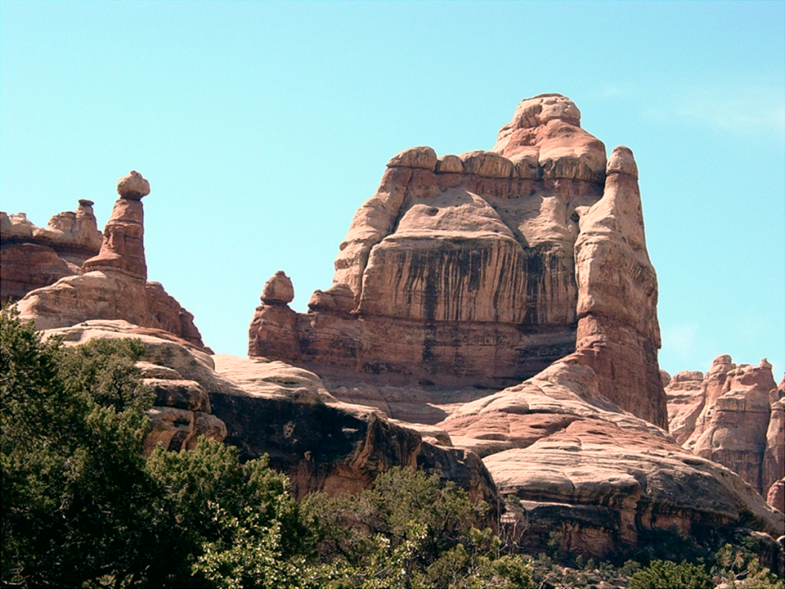
Notes:
The landforms of the Canyonlands may not be of the enormous scale of the Grand Canyon, …

Slide 33
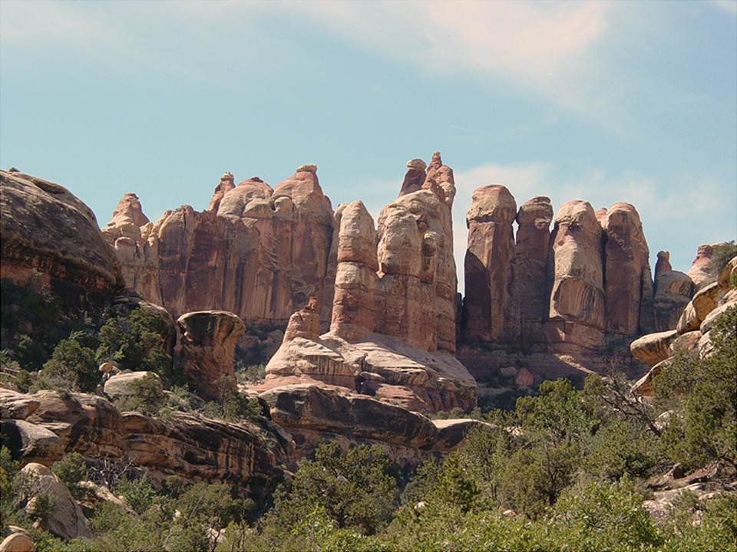
Notes:
… but the abundance …

Slide 34
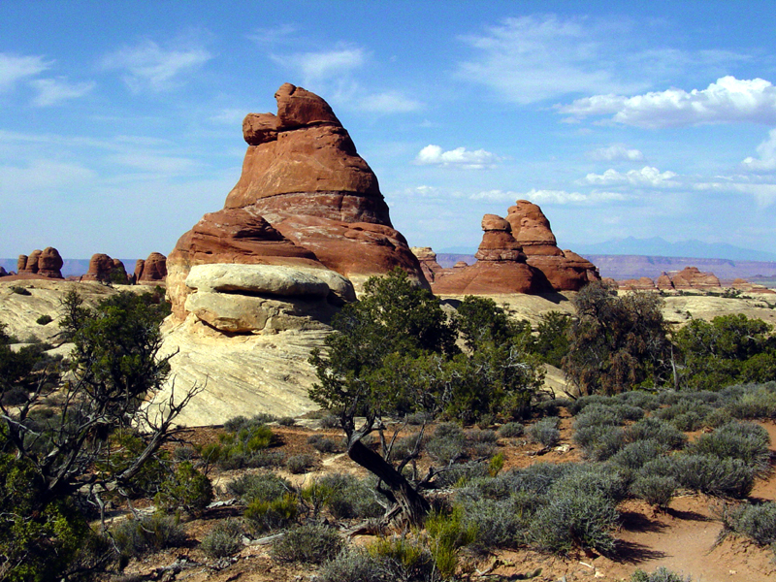
Notes:
… and variety of landforms in Canyonlands …

Slide 35
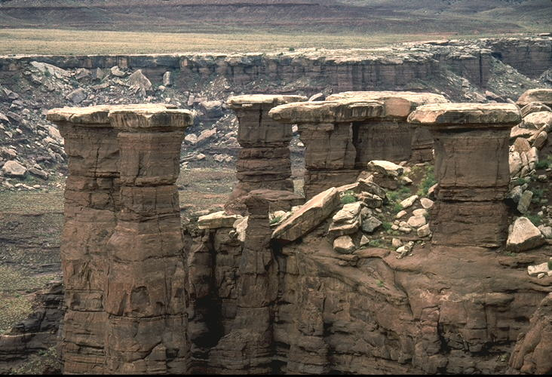
Mushroom Rocks
Notes:
…put it in a class of its own.

Slide 36
Notes:
West of the Needles District across the Colorado River lies the Maze District.

Slide 37
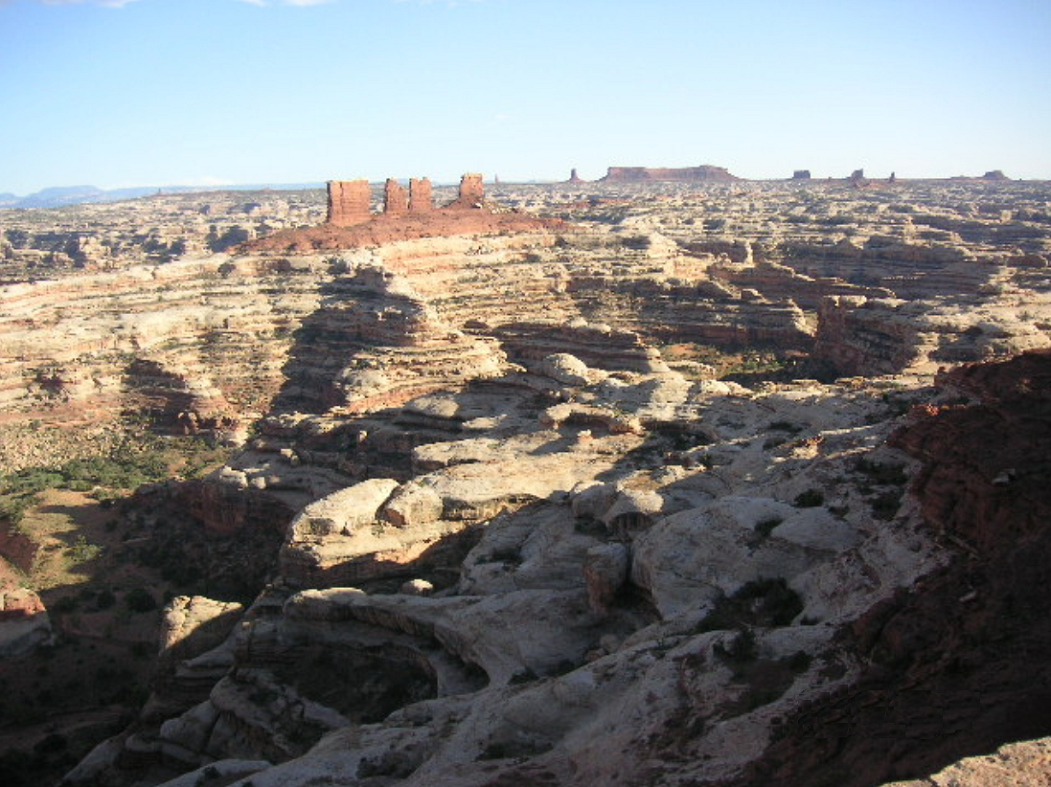
Notes:
Easily the most remote and inaccessible area in the park (if not the entire U.S.), the Maze is a perplexing jumble of canyons that has been described as a "30 square mile puzzle in sandstone".

Slide 38
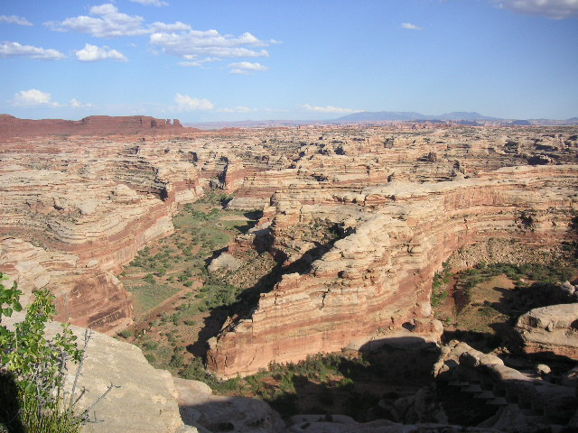
Notes:
The Maze’s thousands of nooks and crannies made it a perfect hide out for outlaws of the old west.

Slide 39
Notes:
Butch, Sundance and the rest of their gang used it for years to evade capture.

Slide 40
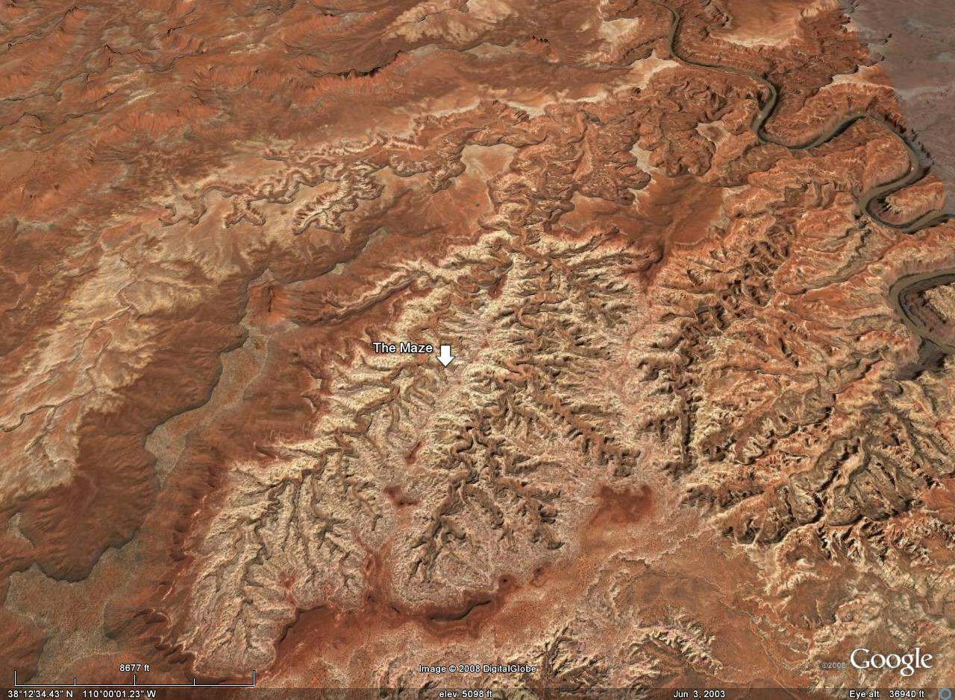
Green River
Notes:
Seen from above, the Maze, albeit intricate, is not without structure. Basically it is a network of closely spaced drainages that flow towards the Green River. Late Cenozoic uplift of the Colorado Plateau increased the gravitational potential energy of these streams, which enhanced their ability to down-cut through the relatively erodible rocks of the region.

Slide 41
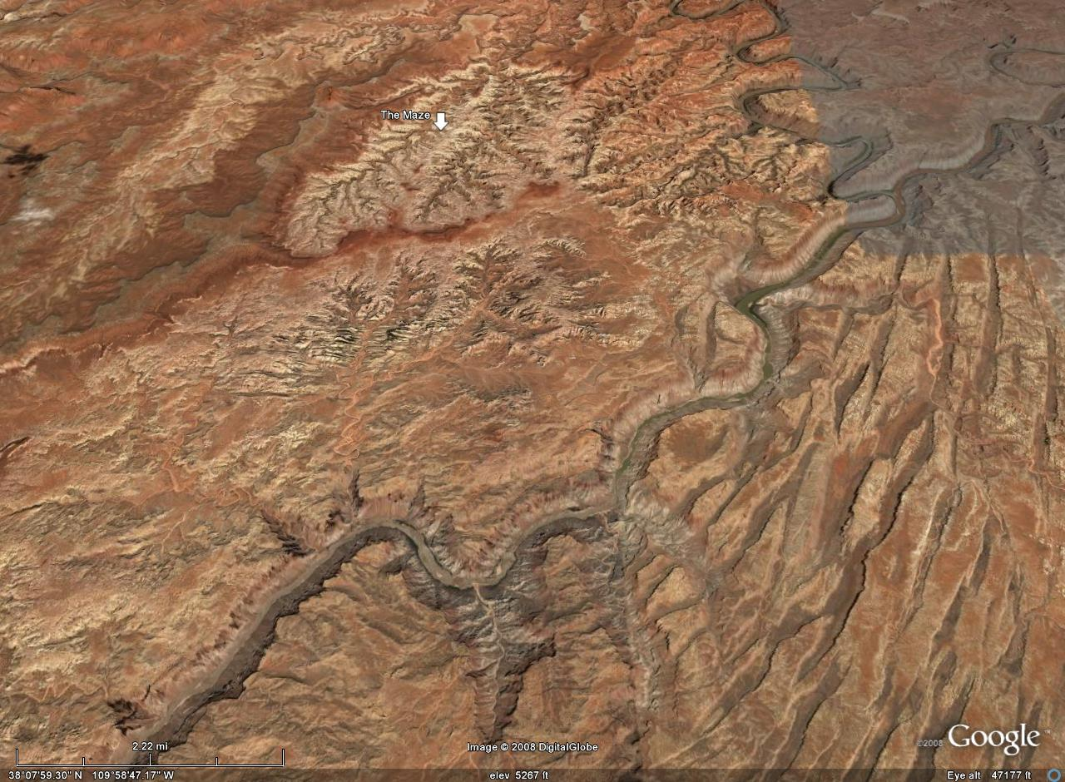
The Maze
Tilt of strata
Colorado River
The Needles
Notes:
Because Maze strata tilt away from the Colorado River, they did not slide toward the Colorado like their counterparts in the Needles District. So salt grabens and vertical joint systems are virtually absent in the Maze.

Slide 42
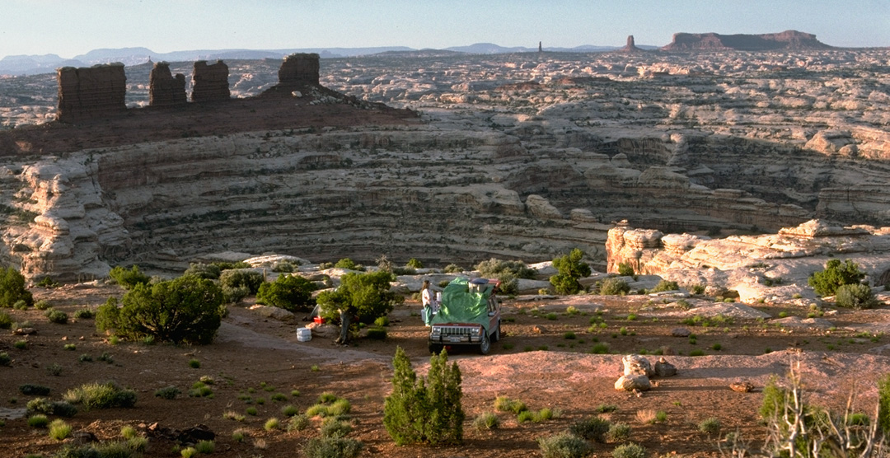
Notes:
If you crave solitude and are ready for some serious backcountry travel and hiking, the Maze may be just what you're looking for.

Slide 43
Notes:
Canyonlands’ rivers not only separate the park’s three districts, but they constitute a forth district of their own.

Slide 44
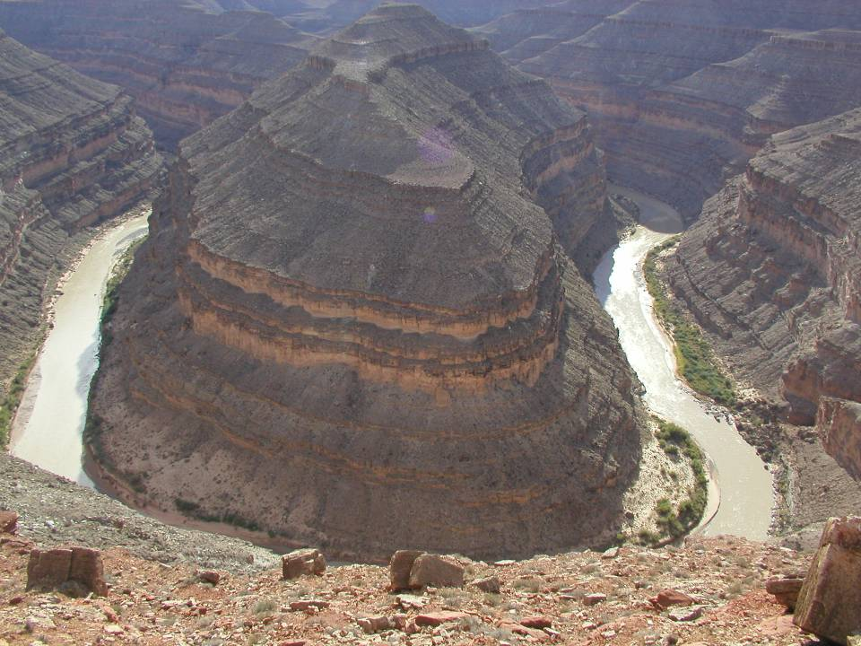
Entrenched Meanders
Notes:
Of greatest geologic interest here are the entrenched meanders which superimpose the features of two different types of rivers. First, the steep sided canyons here are indicative of streams that down-cut rapidly because they have a lot of energy relative to the load of sediment they have to carry. Second, the meandering pattern is characteristic of streams whose sediment load is equal to the streams ability to carry it.

Slide 45
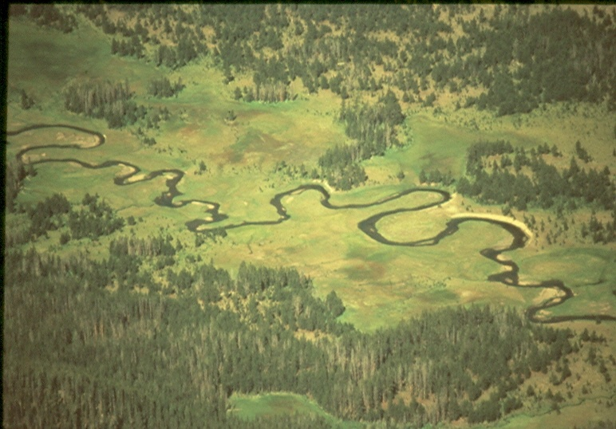
meanders
Notes:
Meandering patterns are generally found where streams flow across broad, flat floodplains. The fact that the two patterns are found together indicates that the Green and Colorado Rivers probably meandered across a broad floodplain before the uplift of the Colorado Plateau, …

Slide 46
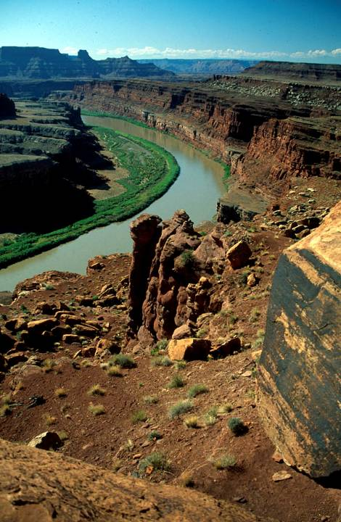
Entrenched meanders
Notes:
… but after uplift they aggressively down-cut into their meandering channels.

Slide 47
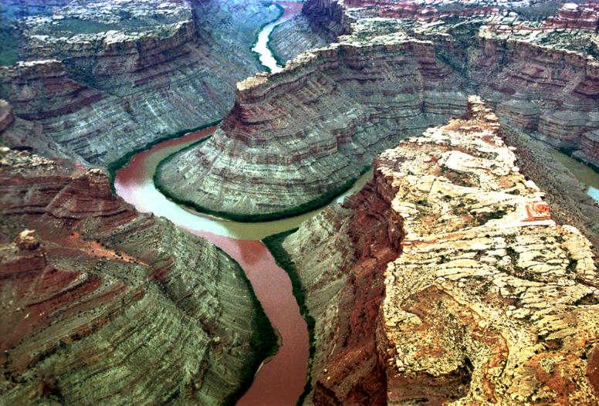
Confluence of Green and Colorado Rivers
Notes:
One of the more dramatic places to see entrenched meanders is at the confluence of the Green and Colorado Rivers, where it is obvious from whence the two rivers derive their names.

Slide 48
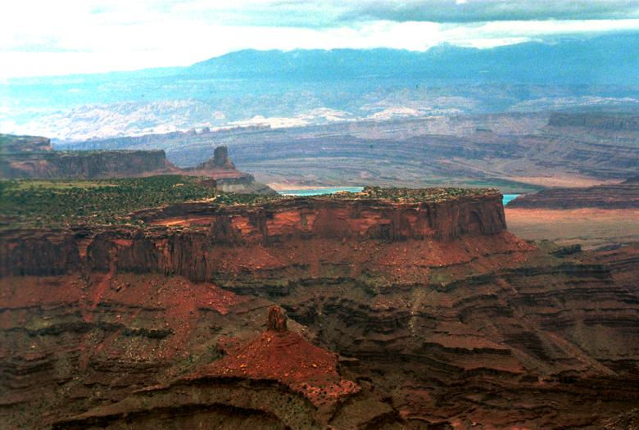
Notes:
Dead Horse Point

Slide 49
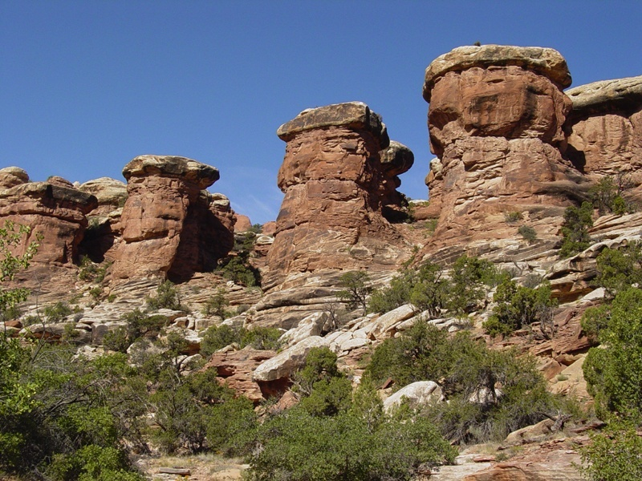
Notes:
Weathering and erosion of the cross-bedded Cedar Mesa Sandstone produce these formations along Elephant Canyon in the Needles District.

Slide 50
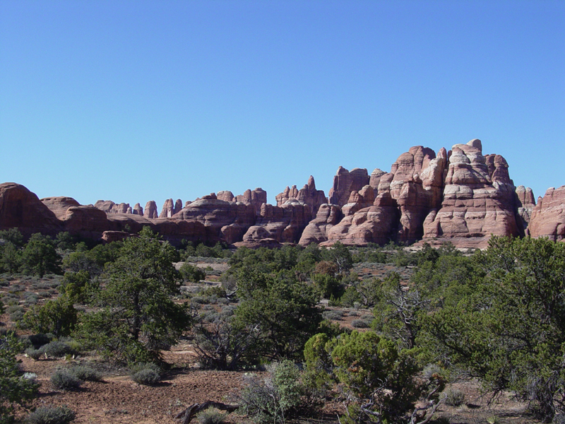
Notes:
View of part of the Needles in Canyonlands National Park. Shrub pinyon pines and junipers grow on the red sandy soil. Between plants, the soil's surface hosts a fragile microbiotic crust consisting of lichens, mosses, fungi, and algae.

Slide 51
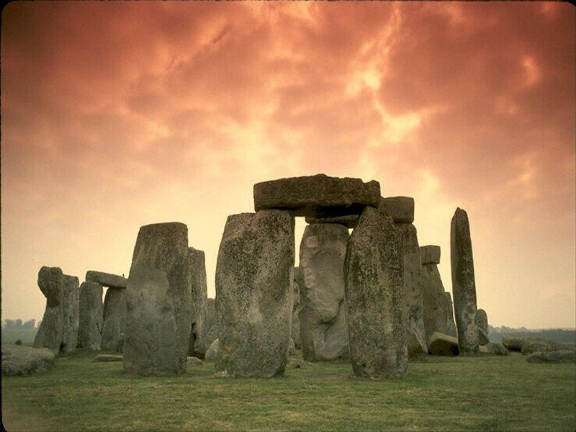

Slide 52
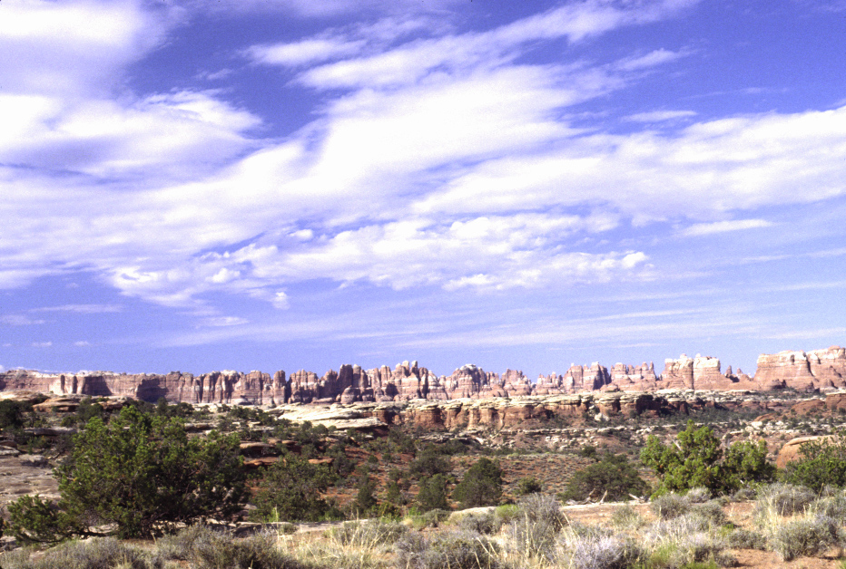
Needles District
Notes:
Once again the brittle sandstone has been fractured along regularly spaced

Slide 53
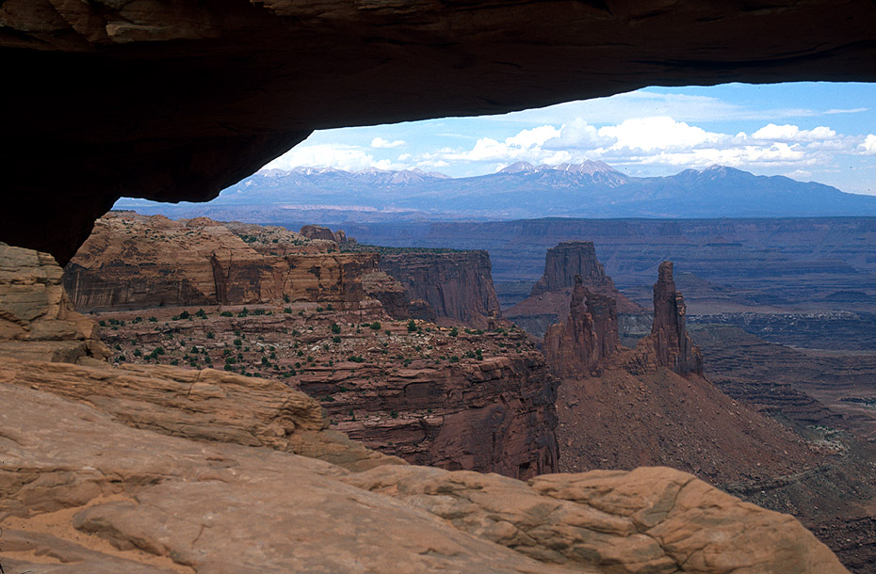
Mesa Arch
Notes:
Cayonlands NP13 SS Mesa Arch, Island in the Sky

Slide 54
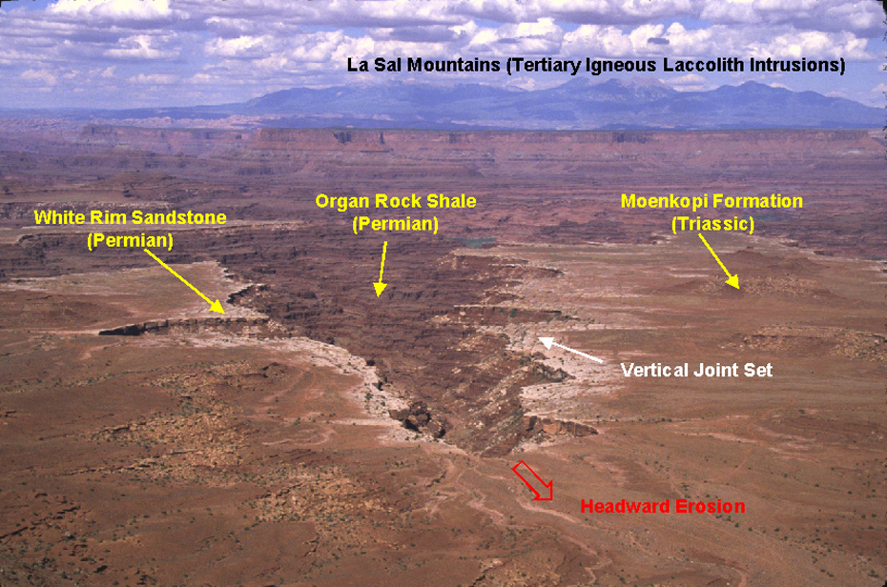
Notes:
Canyonlands O1B DBH Island in the Sky – Annotated by David B. Hacker

Slide 55
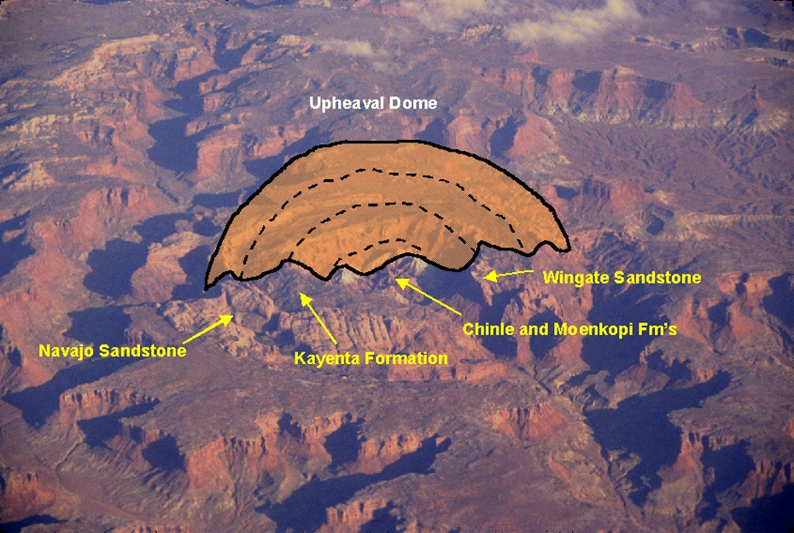
Upheaval Dome pushes up the Mesozoic
Notes:
Canyonlands O3B DBH Upheaval Dome – Annotated by David B. Hacker

Slide 56
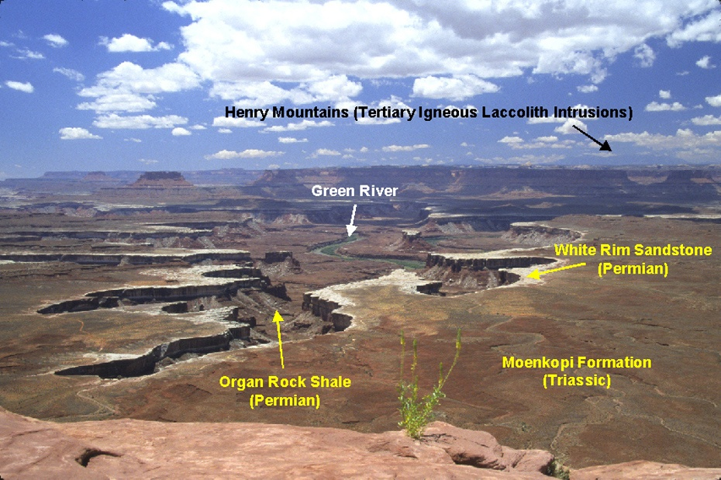
Notes:
Canyonlands O2B DBH Island in the Sky, Green River Overlook – Annotated by David B. Hacker. (Photo by David B. Hacker)

Slide 57
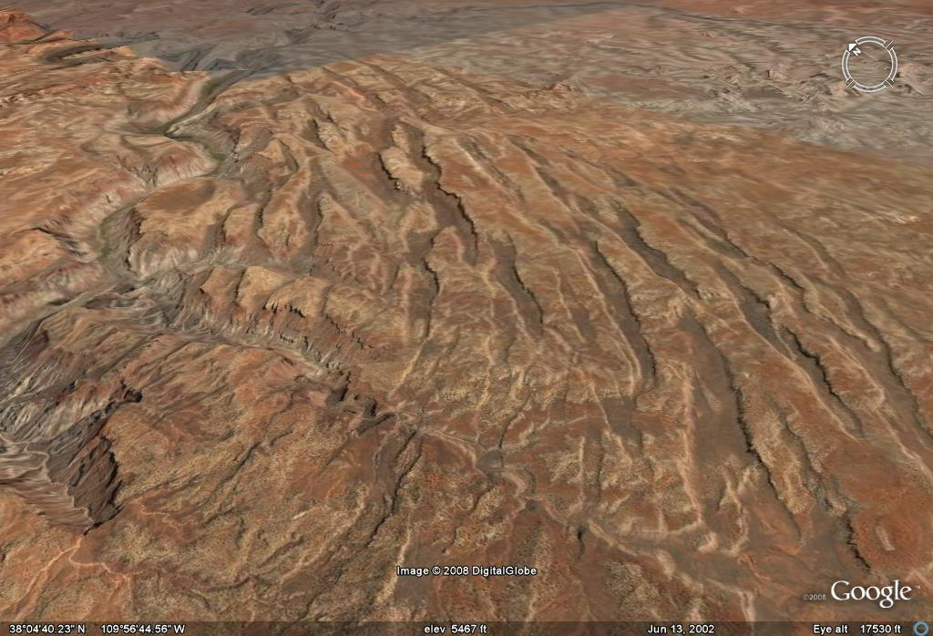

Slide 58
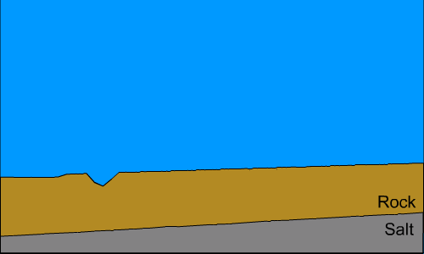
Notes:
First, Laramide

Slide 59
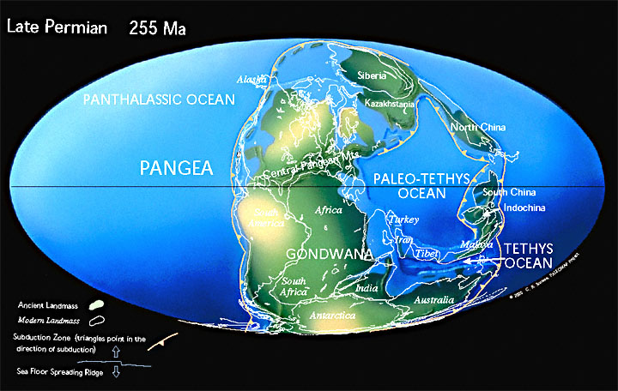
Notes:
That uplift will conclude by the end of the Permian, the time when Pangaea had been pretty much assembled.

Slide 60
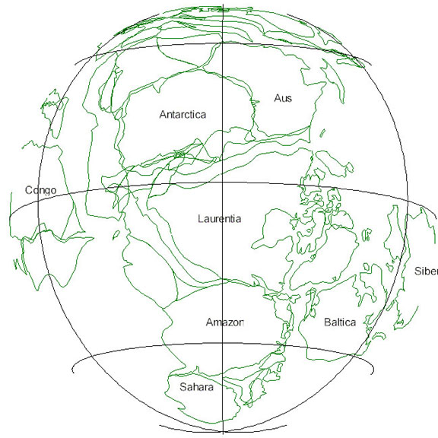
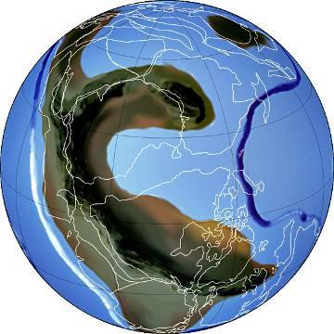
RODINIA
~800 Ma

Slide 65
Cross beds in Sandstone
Notes:
Cayonlands NP11 SS Near Mesa Arch, Island in the Sky

Slide 66
Notes:
The white rim rock of the cliff face is Navajo Sandstone; the ledgey red rock cliffs where the road descends is the Kayenta Formation. Shear cliffs of sandstone are of the Wingate Sandstone. The Wingate and Kayenta formations are of Triassic age, whereas the

Slide 67
Notes:
Canyonlands 2 DBH

